Slide 1
OSTIM INDUSTRIAL MODEL
FOR REGIONAL DEVELOPMENT
AND
CLUSTERING IN TÜRKİYE
Since 1967

Slide 2
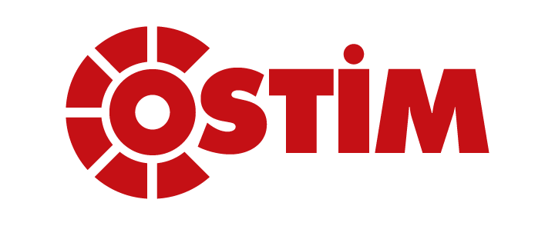
5.000 Enterprises
50.000 Employee
OSTIM has reached to this level within 47 years of hard work

Slide 3
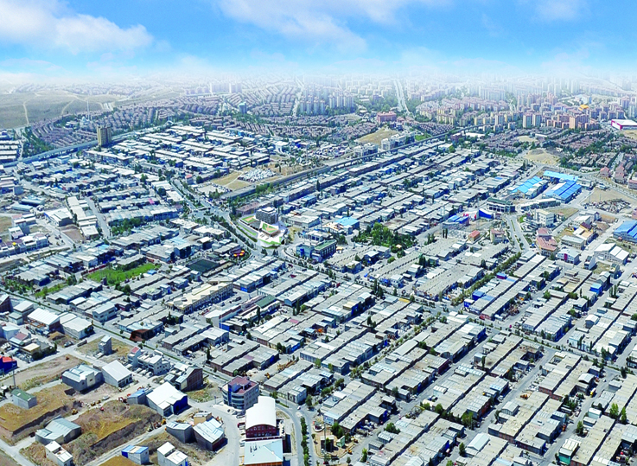
NOWADAYS OSTIM…

Slide 4
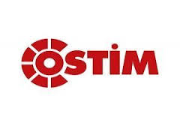
SECTORS IN OSTIM
MACHINE and MACHINERY EQUIPMENT
ELECTRIC and ELECTRONICAL EQUIPMENT
METAL and METAL WORKING
AUTOMOTIVE
CONSTRUCTION MACHINERY
MEDICAL INDUSTRY
CASTING and FORGING
COATINGS
BUILDING and CONSTRUCTION
CHEMICALS
ADVANCED MATERIALS and EQUIPMENTS
PLASTICS and RUBBERS
ENGINEERING and DESIGN
PACKAGING and PRINTING
RENEWABLE ENERGY

Slide 5
CLUSTERS IN OSTIM
CLUSTERS | NUMBER OF COMPANIES
DEFENCE AND AVIATION | 149
CONSTRUCTION MACHINERY | 122
RAIL TRANSPORTATION SYSTEMS | 135
RENEWABLE ENERGY | 62
MEDICAL INDUSTRY | 71
RUBBER TECHNOLOGIES | 43

Slide 6
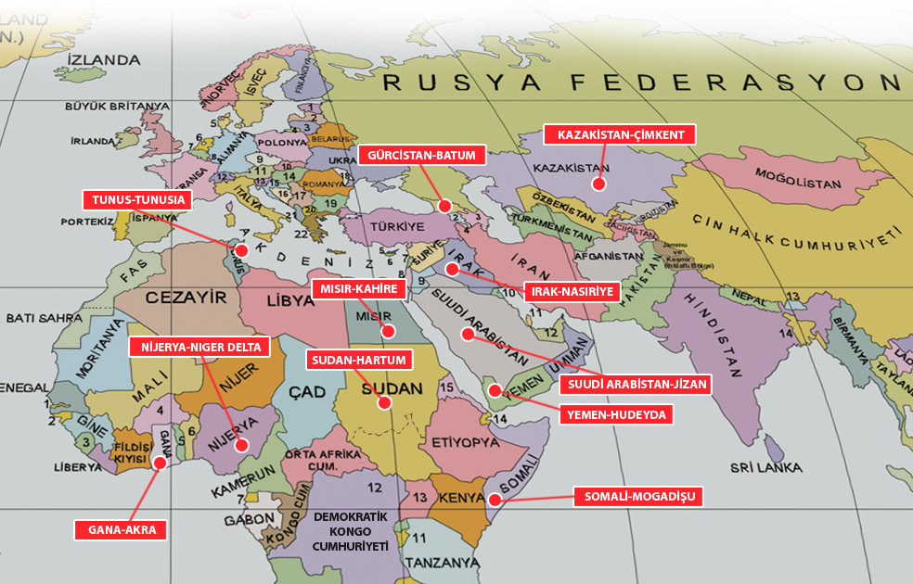
ACTIVITIES AND REFLECTIONS
OSTIM MODEL TRANSFER

Slide 7
DISTRIBUTION OF ACTIVITIES AND RISK
ACTIVITIES TO DO | ORGANIZER | FINANCE
1. NEEDS ANALYSIS | OSTİM + IDB | IDB + GRANT
2. LAND SUPPLY | LOCAL GOVERNMENT- THE GOVERNMENT | FREE
3. PROJECT DESIGN AND CONSTRUCTION | OSTİM | IDB + CREDIT
4. LOCATION OF WORKSHOP AND THEIR ESTABLISHMENT-COOPERATIONS- OPERATION | OSTİM | OSTİM

Slide 8
THANK YOU
FOR YOUR ATTENTION
PROF.DR.SEDAT ÇELİKDOĞAN
www.ostim.org.tr

